Slide 1
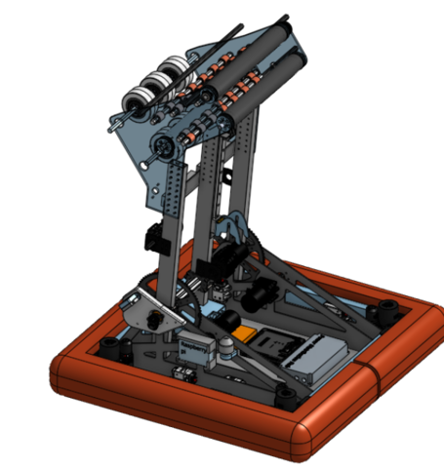


Slide 2
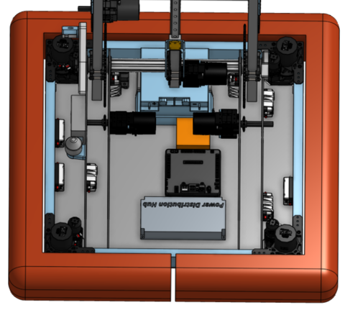

Slide 3
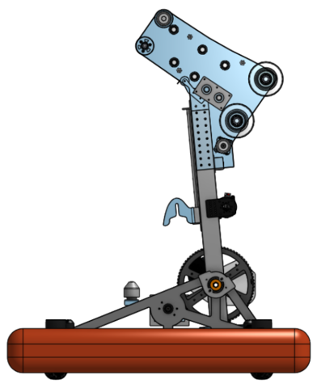

Slide 4
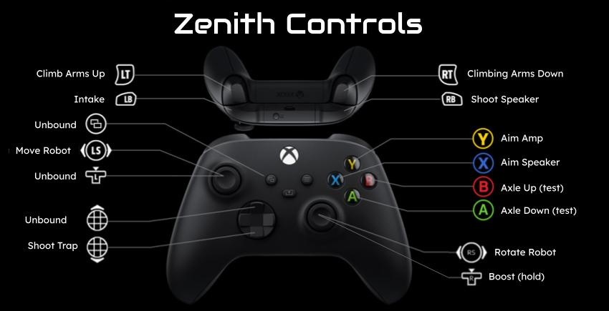

Slide 5
Robot Systems
Intake
Break beam sensor
Rollers
Belt System
Shooting Angle
Polycarbonate side panel
Infrared sensor
Climber
Unique hook shape
Spring and String
Rail
Drive Train
Swerve Drive
Max swerve modules
Shooter
Different angles for amp and speaker

Slide 6
Robot Systems
Shoulder/Arm
Side panels
Big chunky gears
Spacing
Bracing
Main axle
Middle shaft
Encoders
Gear Chains
Electrical
CAN
Battery analyzation system
Wire management
Component mounting
PICTURE HERE

Slide 7
Programming
Auto aiming
Driving subsystems
Climbing subsystems
Intake subsystems
Max swerve
Shooter subsystems
Ultrasonics
Infrared sensor
Vision
Unicorn hat (LED Feedback)
Autonomous
Multiple starting positions
Shoot into Speaker
Shoot into Amp
Pick up 2 notes
AprilTags
2 camera
Detecting AprilTags and notes

Slide 8
Design
Intake and shooter efficiency and structure
Combine several features into 1 mechanism
Axle location for different actions (Amp and speaker)
Cable management
Basic climb design incorporating existing systems

Slide 9
Design

Slide 10
Innovative Parts of our Robot What we can do
Wire and cable management
Focusing on both amp and speaker at different angle
Mechanical–Infrared/Break beam sensor, limit switches, ultrasonic sensor
Unicorn hat and LEDs to communicate data to driver
Intake from the ground
Shoot into Speaker
Shoot into Amp
Climb
Drive under stage

